Slide 1
Investigation of two CFD validation test cases for turbulent mixing of different gaseous species (fuel and oxidizer) in typical laboratory flame configurations
Student : Malav M Soni
Supervisor : Jun.Prof.Dr.Rinie Akkermans & Dr. Thorsten Möller
Date : 12/11/2015

Slide 2
Content
Objective
Turbulence and its theory
Part I (Sandia National Laboratory Propane Jet)
Experimental Data
Computational Domain
Quality Criteria
Conclusion
4. Part II (Sydney Bluff Body Jet)
Experimental Data
Computational Domain
Quality Criteria
Conclusion
Summary
Experimental References

Slide 3
Objective
To study and investigate the flow structure and the turbulent mixing behind the bluff body, in the absence of complex combustion chemistry and heat release i.e. isothermal, with different RANS models
ANSYS CFX 16.1 and ANSYS Fluent 17.0
This study is divided in to parts:
Part I : Investigation of the Sandia National Laboratory Propane Jet (quasi-2d)
Part II : Investigation of Sydney Bluff Body Jet Flame (full 3d)

Slide 4
2. Turbulence and its theory
What is turbulence ?
Navier stokes equation can be used to describe both laminar and turbulent flows without the need for additional information
Alternative :
Mathematical model which accounts for the effects of turbulence without being computationally expensive
Turbulence can be described as:
Reynolds Number
Non-linear process
Rotational flow structures
Phenomenon
Disadvantage : Computationally expensive

Slide 5
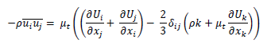
Turbulence and its theory
Time Averaging
DNS
LES
RANS
Reynolds stress model (RSM)
Algebraic RSM
Differential RSM
Eddy Viscosity model
(EVM)
Zero equation model
One equation model
Two equation model
Boussinesq Approximation
Individual equations solved for all the components of Reynolds stresses
k-ω, k-ԑ etc

Slide 6
Content
Objective
Turbulence and its theory
Part I (Sandia National Laboratory Propane Jet)
Experimental Data
Computational Domain
Quality Criteria
Conclusion
4. Part II (Sydney Bluff Body Jet)
Experimental Data
Computational Domain
Quality Criteria
Conclusion

Slide 7
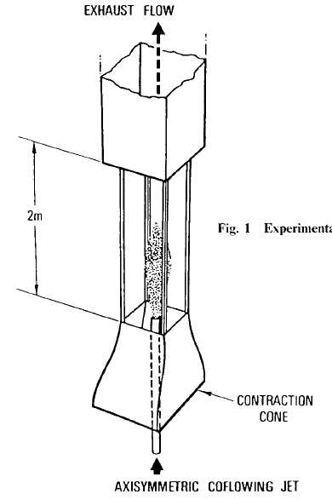
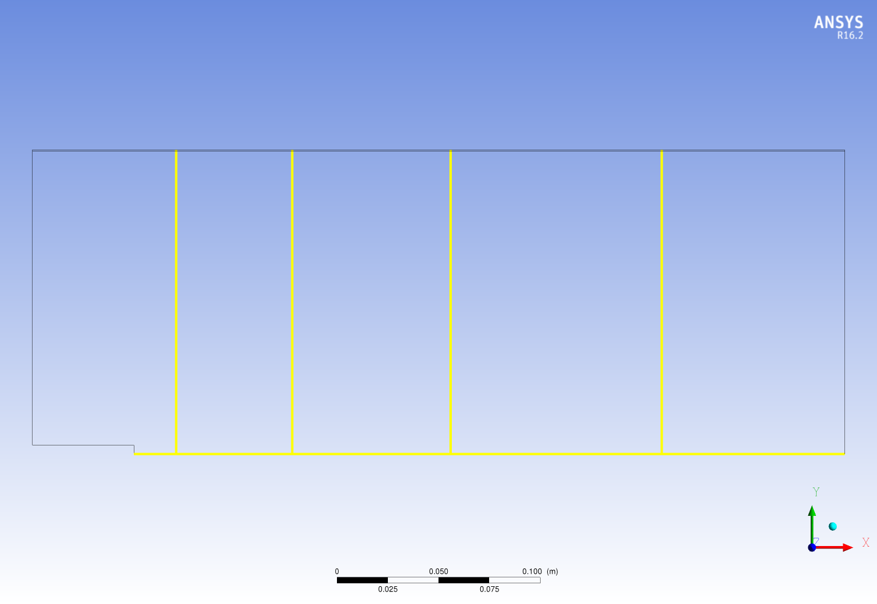
3. Sandia Propane Jet (Test case description)
Measuring Instrument | Quantities measured
Laser Doppler Anemometer (LDA) | Velocity
Rayleigh Scattering | Mixture fraction
X/D = 4
X/D = 15
X/D = 30
X/D = 50
Y/D = 0
AXISYMMETRIC FUEL JET

Slide 8
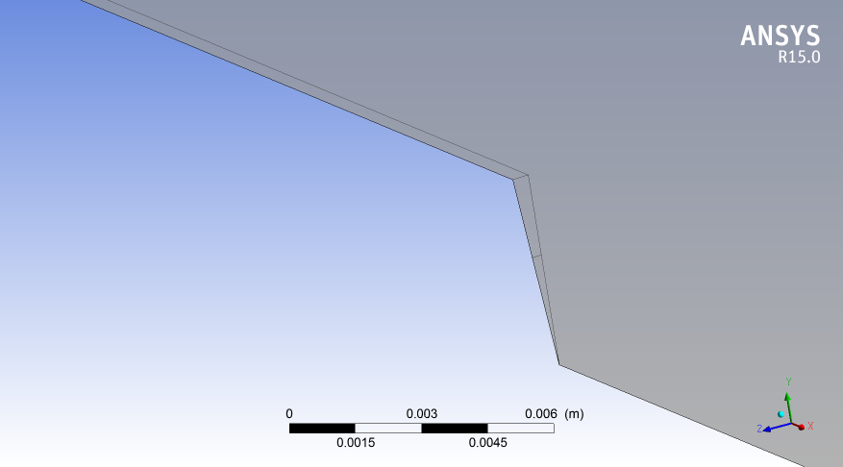
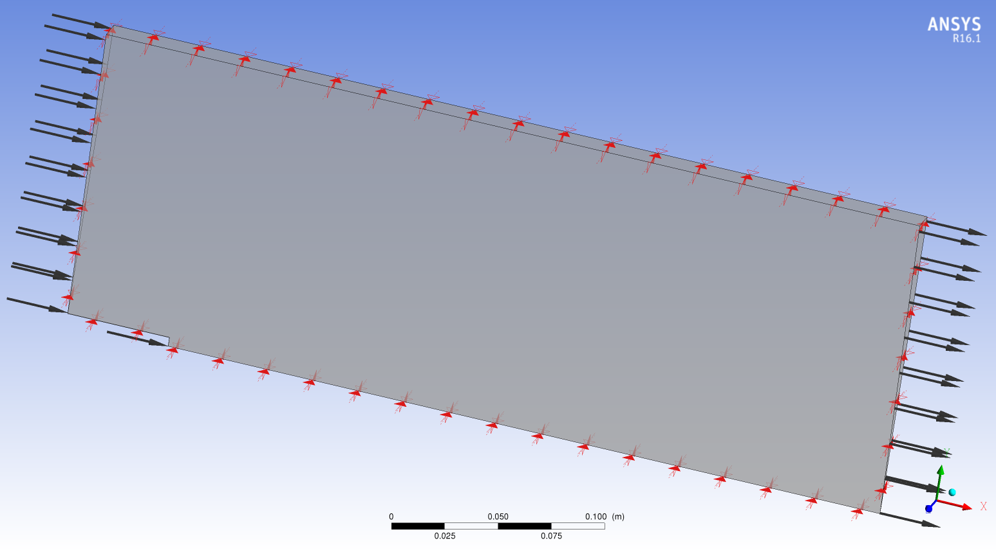
Computational Domain
No Slip Wall
Outer wall
Co-Flow Air Inlet
Bluff body
Propane Jet Inlet
Monitoring Points
Pressure Outlet
Propane Jet Inlet
No Slip Wall
Front & back surfaces of the Comp. Domain are Symmetry planes

Slide 9
Quality Assurance (ANSYS CFX 16.1)
The following investigations have been carried out in order to assure the quality of the CFD simulation:
Iteration error
dependence of CFD solution on the strength of the applied convergence criterion
Spatial Discretization error
grid independence of the CFD solution
Turbulent inlet boundary condition study
Turbulent Schmidt number (Sc_{t}) study
different Sc_{t} ranging from 0.6 – 0.9 are used to study with which Sc_{t} the result with best accuracy is delivered
Model error
comparison of SST, k-ω, k-ԑ, BSL RSM and EARSM turbulence models

Slide 10
Test of Turbulent Inlet Boundary Conditions (TIBC), Mesh 4
Test to check the appropriate TIBC
Turbulent kinetic energy (k) and length scale (LS) used
Round jet anomaly phenomenon
K-ω SST and Standard K-ԑ models are used in combination with different TIBC`s
Propane mass fraction , velocity profiles compared with each other as well as with the experimental data

Slide 11
Test of Turbulence Inlet Boundary Condition (TIBC)
Test Name | Turbulence Model | Turbulence Boundary Condition Fuel Inlet | Turbulence Boundary Condition Air Inlet
CSV_SST | SST | K and ω | Fractional Intensity & Eddy Viscosity ratio
CSV_KEpsilon# | K-ε | K and ε | Fractional Intensity & Eddy Viscosity ratio
KLS_SST | SST | K and LS | K and LS
KLS_KEpsilon# | K-ε | K and LS | K and LS
Propane_Air_Inlet_ CSV**(PA CSV SST) | SST | K and ω | Fractional Intensity* & Eddy Viscosity ratio
Round Jet Anomaly : The standard k-ε model with the standard coefficients delivers the velocity field quite accurately in two-dimensional plane jet, but large errors occur for the axisymmetric jets. Specifically, the spreading rate of round jet is overestimated by 40% [Ref. Pope].
Reason : Modeling of dissipation (ε) equation

Slide 12
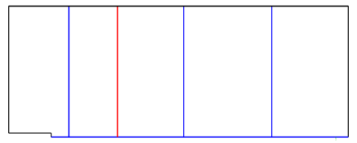
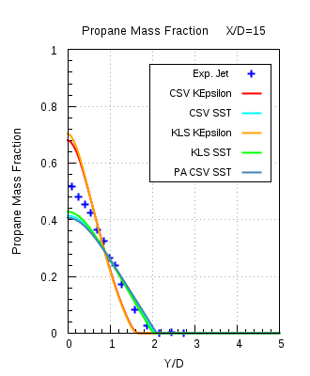
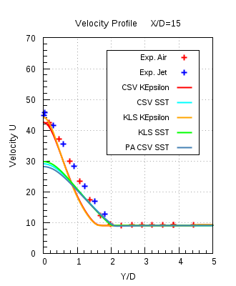
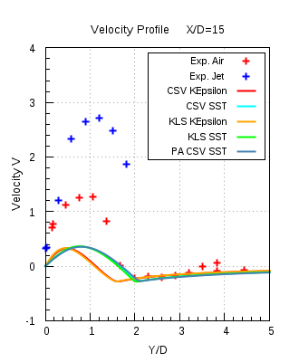
TIBC – Results comparison
ANSYS CFX 16.1

Slide 13
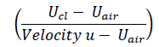
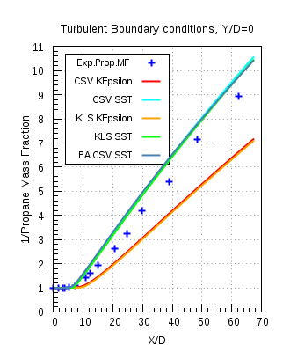
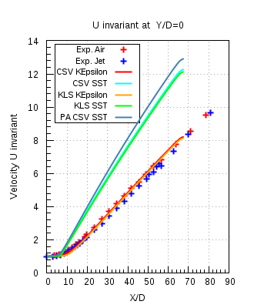
TIBC – Results comparison
ANSYS CFX 16.1

Slide 14
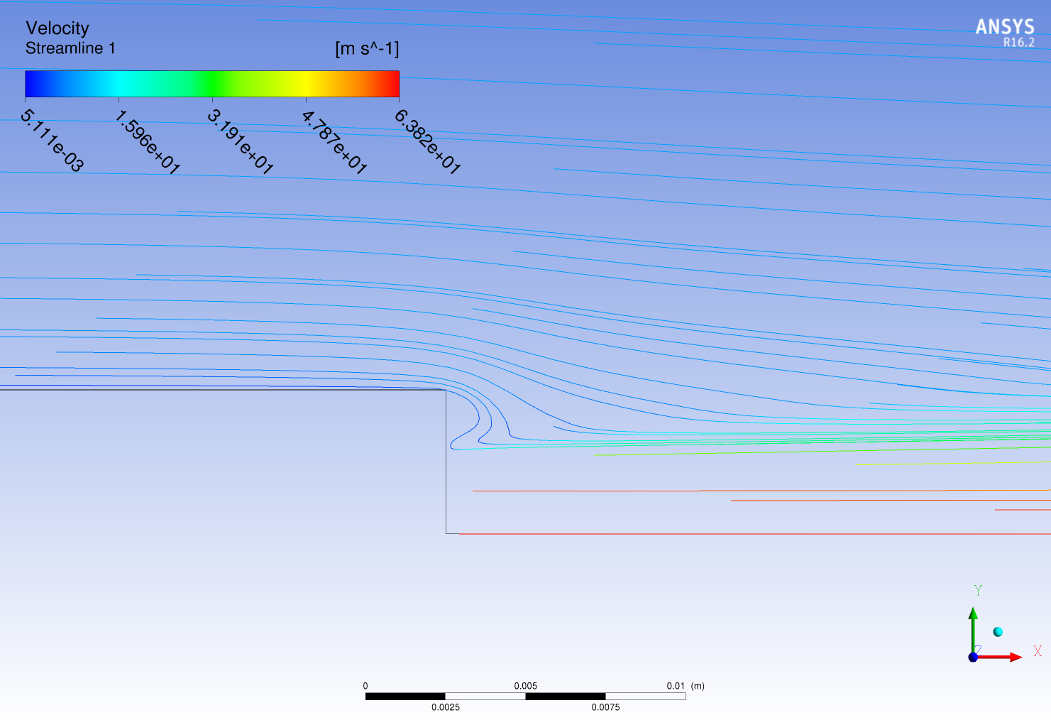
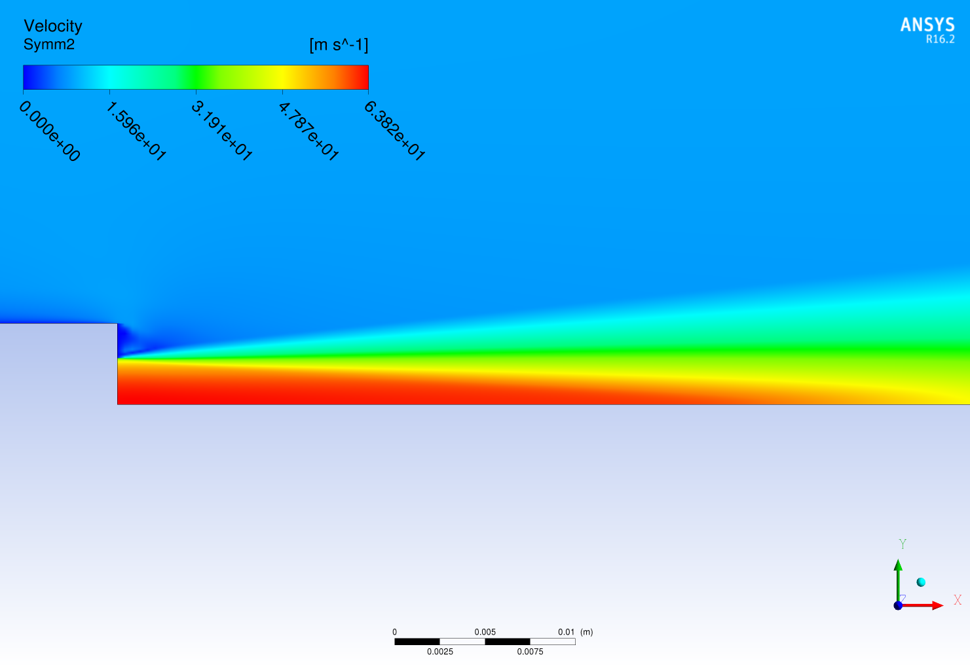
TIBC – Results
PA CSV SST

Slide 15
Model Error Study, Mesh 4
For this study the following turbulent models are used :
K-ω SST
K-ε
K-ε modified (KEpsilonmod)
BSL RSM (Base line reynolds stress model)
EARSM (Explicit algebraic reynolds number)
Resulting profiles for the propane mass fraction and velocities are compared with the other turbulence models and the experimental data

Slide 16
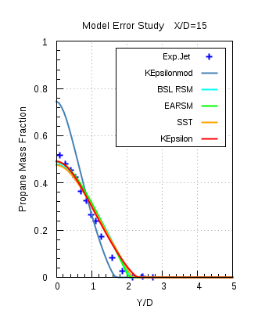
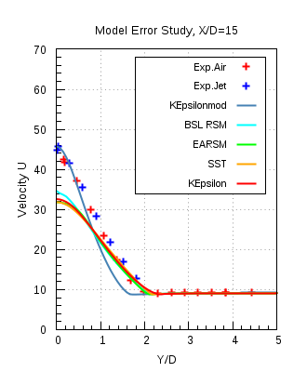
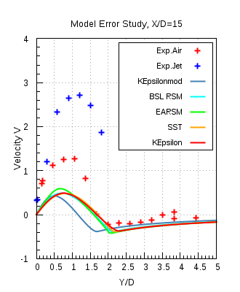
Model Error - Results
ANSYS CFX 16.1

Slide 17
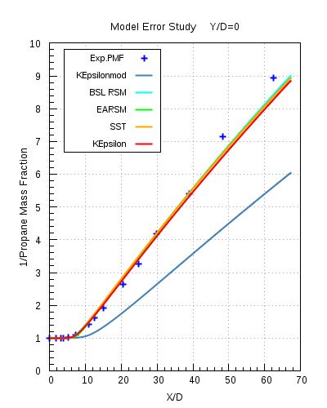
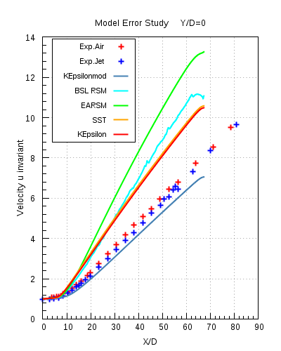
Model Error- Results
ANSYS CFX 16.1

Slide 18
Solver Comparison between ANSYS CFX 16.1 and ANSYS Fluent 17.0, Mesh 4
The following two turbulence models are used for the solver comparison
K-ω SST
K-ε

Slide 19
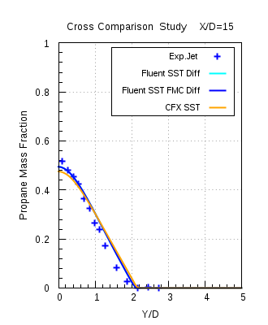
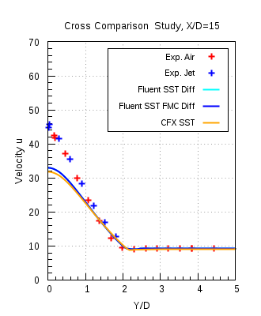
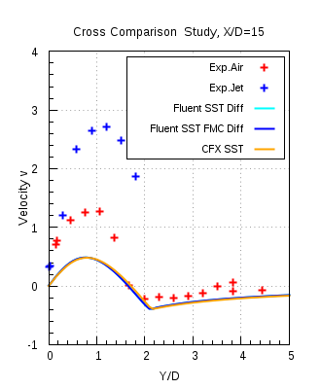
Solver Comparison
ANSYS CFX 16.1 and ANSYS Fluent 17.0
k-ω SST

Slide 20
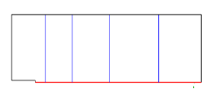
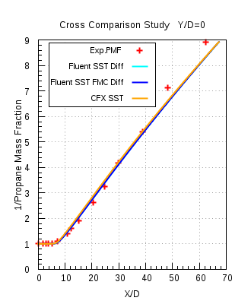
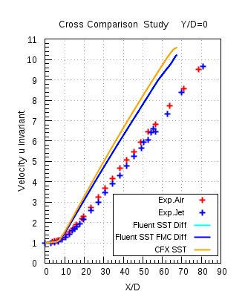
Solver Comparison
ANSYS CFX 16.1 and ANSYS Fluent 17.0,
k-ω SST

Slide 21
Conclusion
In this test case the investigation of the turbulent mixing of species in the recirculation zone behind the bluff body was carried out with isothermal and steady state flow conditions
K-ω SST model would be the recommended turbulence model. Both k-ε models give almost the same level of accuracy in this investigation, but with more difficulties in obtaining a converged solution
Differences observed in the axial velocity profiles is due to the simplifying assumptions made in the RANS turbulence models and also due to the round jet anomaly
Modification in the model constants is not suggested
improves comparison of velocity profiles
but at the price of deteriorated Propane mass fraction profiles
If desired, higher accuracy results can be obtained with e.g. Large Eddy Simulation (LES) or hybrid models, but at much higher computational costs

Slide 22
Content
Objective
Turbulence and its theory
Part I (Sandia National Laboratory Propane Jet)
Experimental Data
Computational Domain
Quality Criteria
Conclusion
4. Part II (Sydney Bluff Body Jet)
Experimental Data
Computational Domain
Quality Criteria
Conclusion

Slide 23
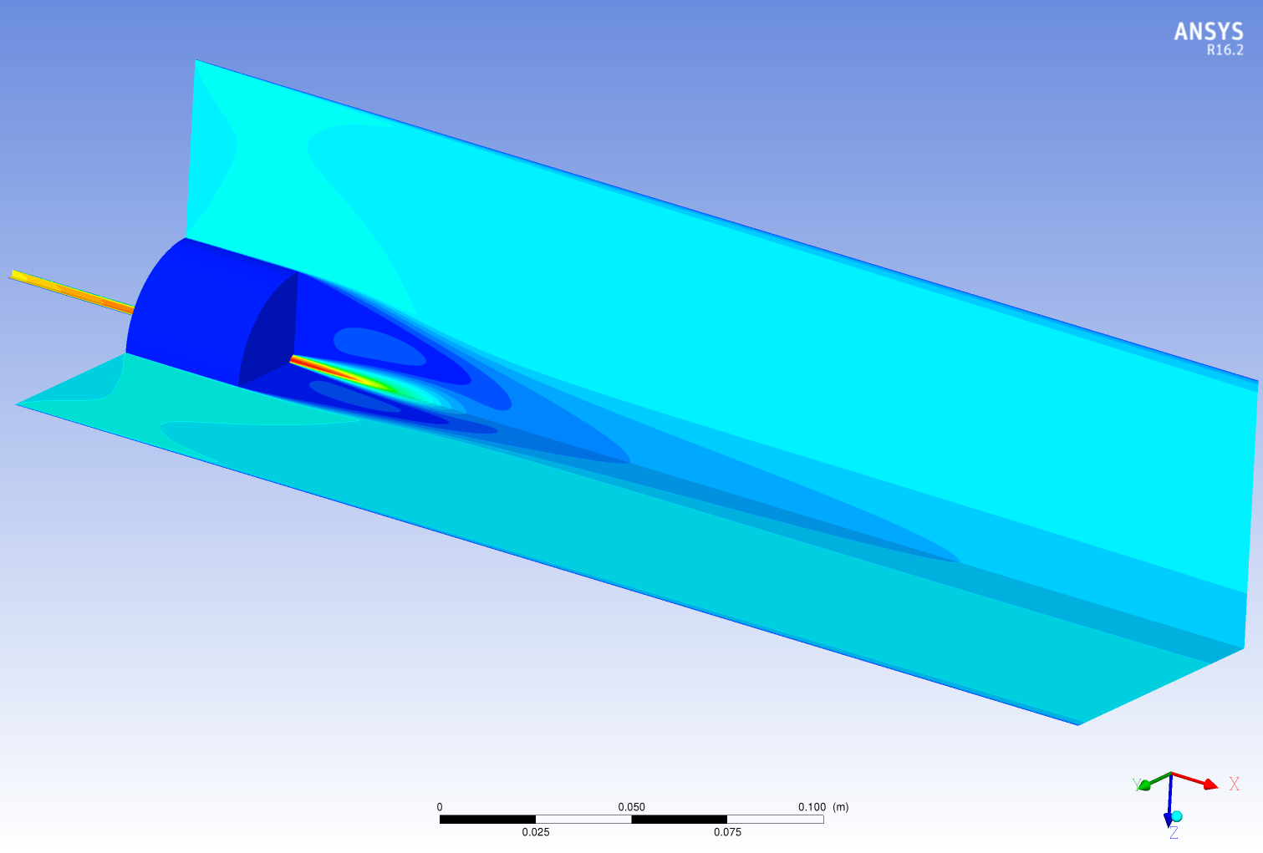
4. Part II - Sydney Bluff Body Jet

Slide 24
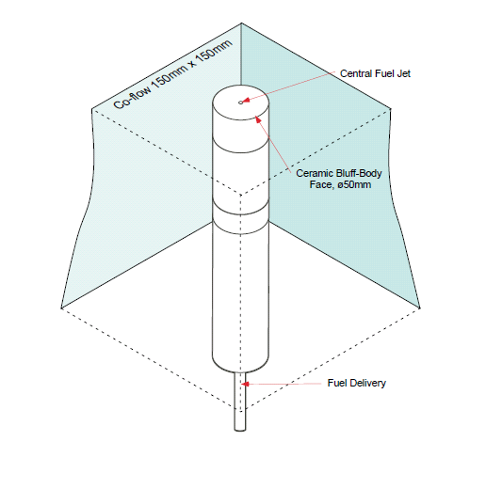
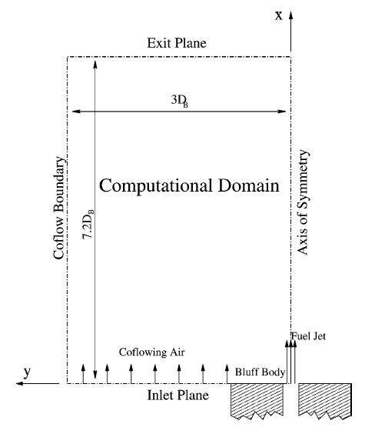
Experimental Setup
1.5D_{b}
6.08D_{b}
Fig (a) Sydney bluff body burner placed in the wind tunnel
Fig (b) 2D axis-symmetric experimental setup

Slide 25
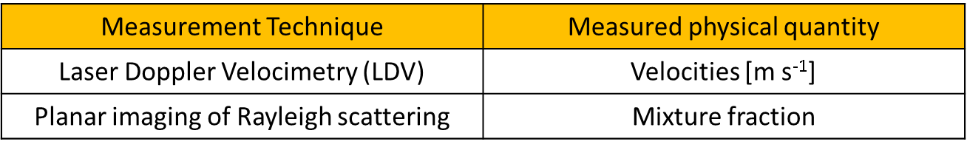
Experimental data
Experiment has been performed in two parts
Constant density flow : Velocity profiles were measured
Variable density flow : Mixture fraction profiles were measured
Air velocity in co-flow is 20 [m s⁻¹ ] in all cases
For fuel different velocities are being considered for different fuels:
Air : 61 [m s⁻¹]
CNG : 50, 85, 143 [m s⁻¹]
Ethylene : 50, 63, 80 [m s⁻¹]
LPG : 50, 70 [m s⁻¹]
Temperature T_{inlet} : 298 [k]

Slide 26
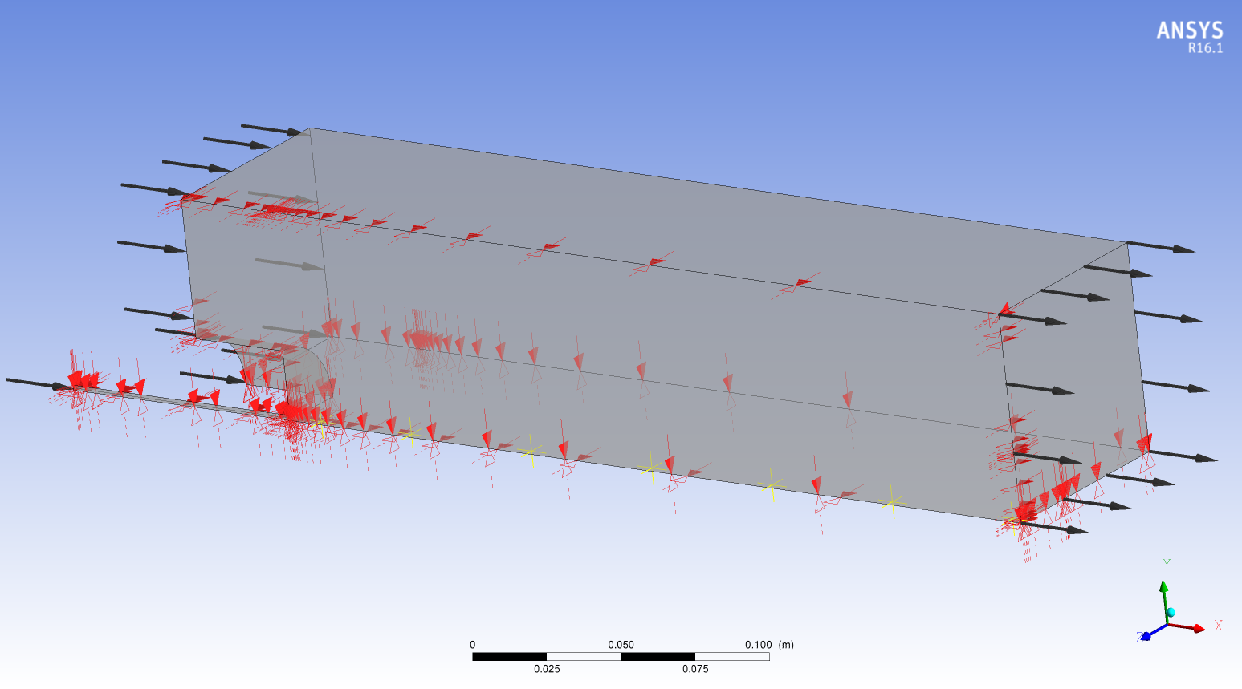
Computational Domain
Co-flow inlet
Top and back Wall 1 & 2
Pressure Outlet
Fuel inlet
Front and bottom Symmetry 1 & 2

Slide 27
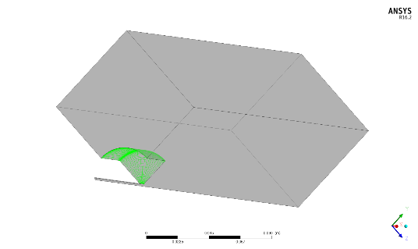
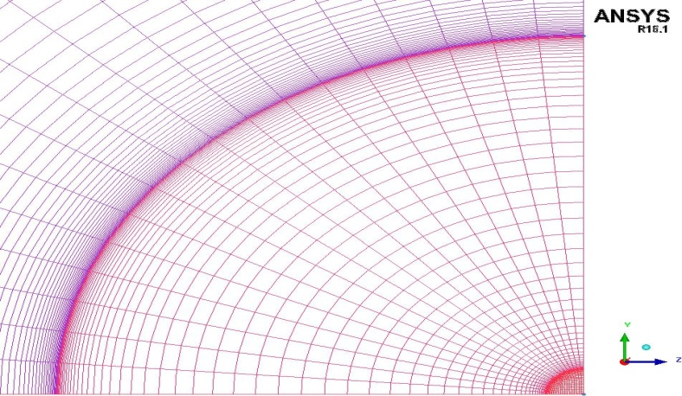

Computational Domain & Meshes
 | Mesh 1 | Mesh 2 | Mesh 3
Elements | 445779 | 3649862 | 12367909
Nodes | 477248 | 3773055 | 12648672
Max. Aspect Ratio | 665 | 1864 | 3046
Min. Grid Angle | 45° | 44.19° | 40.95°
Mesh 1
Mesh 3

Slide 28
Solver Comparison between ANSYS CFX 16.1 and ANSYS Fluent 17.0, Mesh 2
The following turbulence models are used for the solver comparison
k-ω SST
standard k-ε
realizable k-ε
The results shown here are computed with fuel CNG with Jet velocity 50 m/s, with standard k-ε and realizable k-ε model

Slide 29
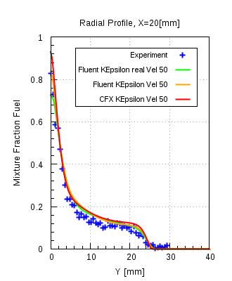
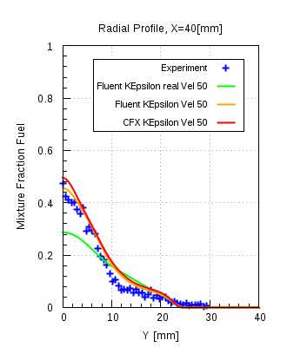
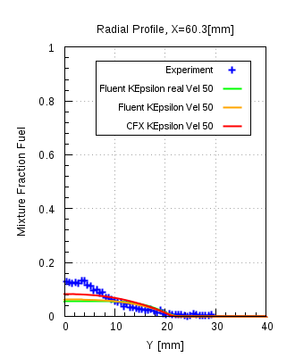
Solver Comparison
ANSYS CFX 16.1 and ANSYS Fluent 17.0,
CNG

Slide 30
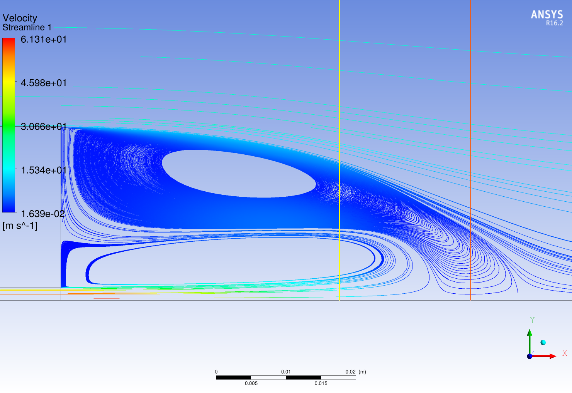
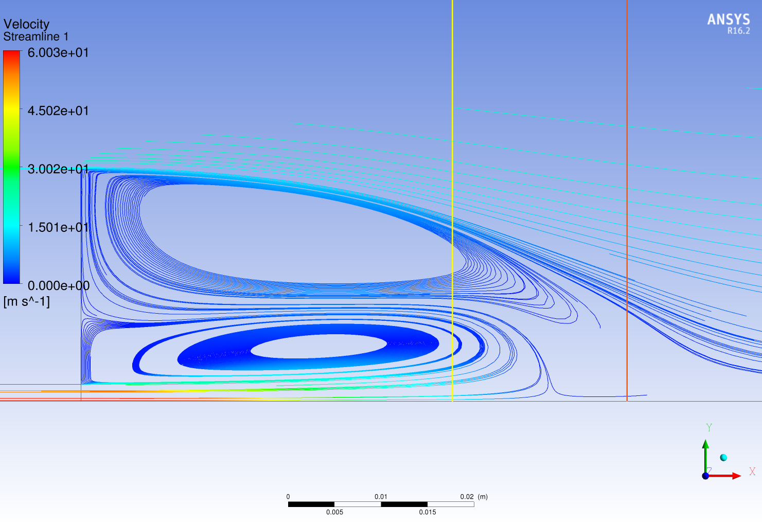
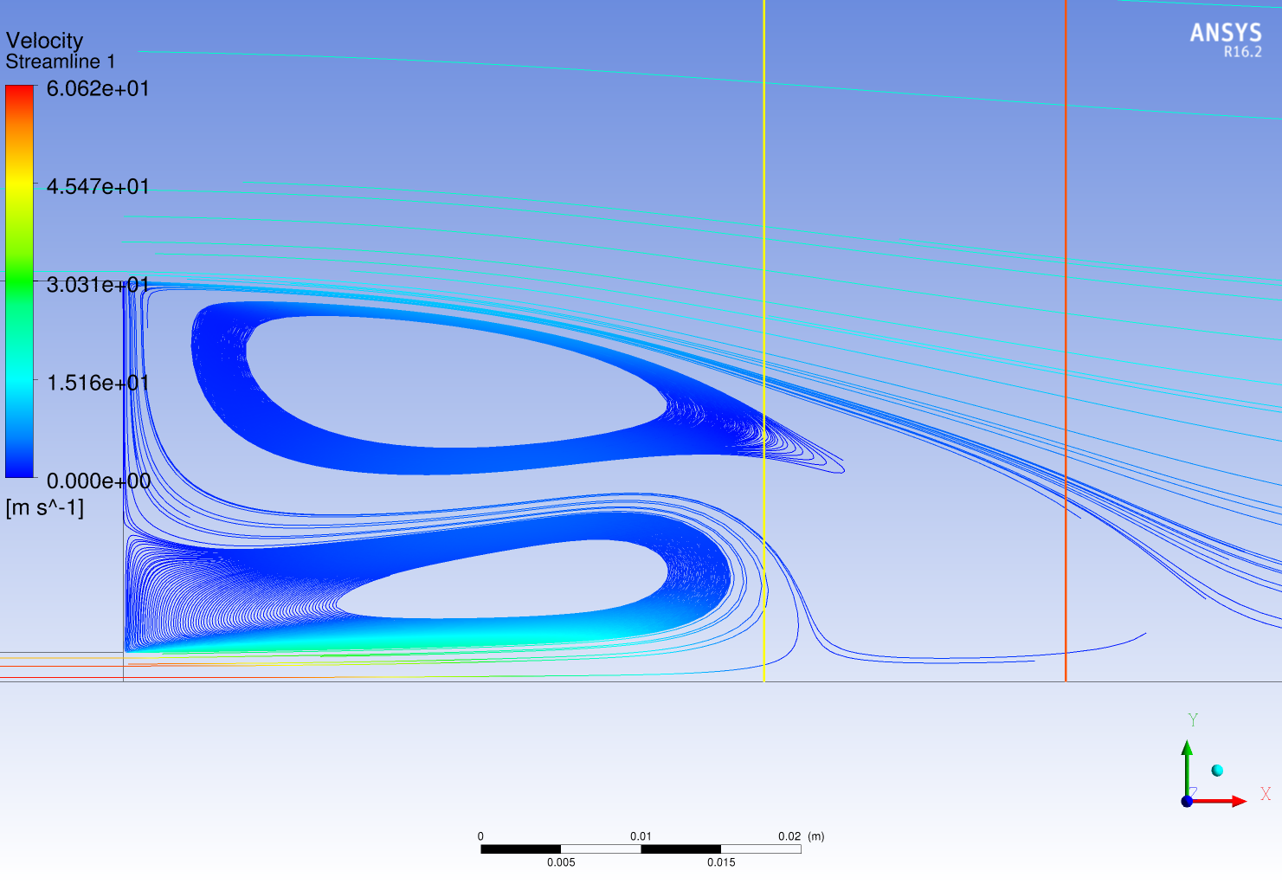
Solver Comparison
ANSYS CFX, K-ε, CNG, jet velocity = 50 [m s⁻¹]
ANSYS Fluent, K-ε
ANSYS Fluent, K-ε realizable

Slide 31
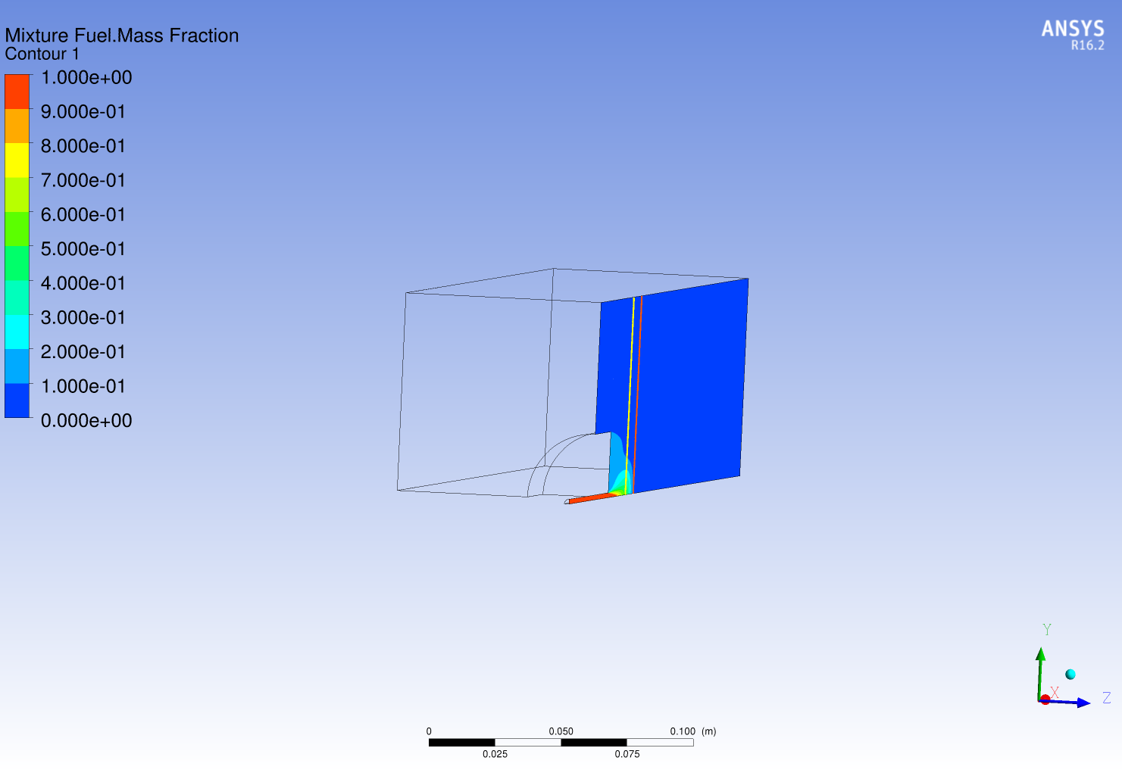
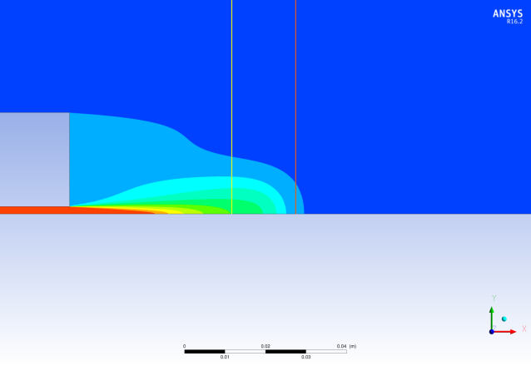
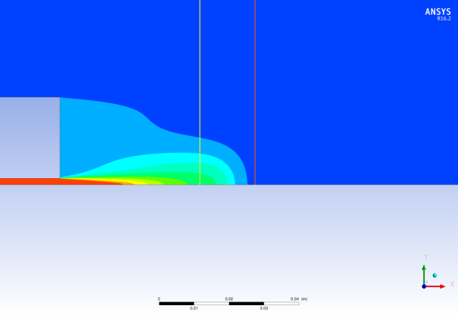
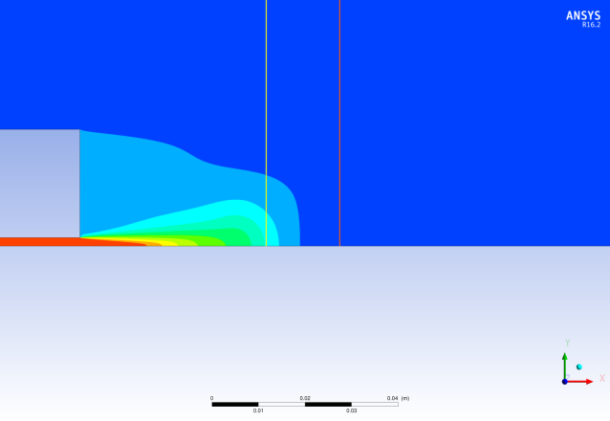
Solver Comparison
ANSYS CFX, K-ε, CNG, jet velocity = 50 [m s⁻¹]
ANSYS Fluent, K-ε
ANSYS Fluent, K-ε realizable

Slide 32
Conclusion
Two fully developed vortices are present in the recirculation zone
k-ω SST and standard k-ε model are the recommended turbulence models for the case of non-reacting turbulence mixing of the species
Realizable k-ε model over-predicts the mixing at certain locations in the downstream direction, specifically in case of CNG it is more prominent
Apart from that for all investigated cases the solutions of ANSYS CFX 16.1 and ANSYS Fluent 17.0 are in fairly good agreement with each other, as well as with the experimental data
Also, a comparison of the size of the recirculation zone, behind the bluff body, obtained from numerical results and experiment showed that they are of similar size (~ 50 [mm] as mentioned in the secondary reference)

Slide 33
5. Summary
Sandia National Laboratory Propane Jet:
k-ω SST would be the recommended turbulence model. It was in good agreement with the experimental data
Differences associated with the velocity profiles were though of due to the simplifying assumptions in RANS models
Modifications in the turbulence models is not recommended
Sydney Bluff Body Jet:
For this case the recommended turbulence models would be k-ω SST and standard k-ε model . As it was seen from the results that they were in good agreement with each other as well as with the experimental data.
Realizable k-ε model will not be recommended for this case where we had a complex recirculation region
Future Work:
The results of this investigation performed in the non-reacting conditions will be taken as the reference and used for carrying out the reacting flow studies for the respective test cases.

Slide 34
6. Experimental References
Sandia National Laboratory Propane Jet:
Robert W. Schefer “Data Base for a Turbulent, Non-premixed, Non-reacting Propane-Jet Flow “, Sandia National Laboratories Research Report, 1985, pp. 1-21.
R.W.Schefer and R.W.Dibble, ”Mixture Fraction Field in a Turbulent Non-reacting Propane Jet”, AIAA Journal, Vol.39, no.1, pp.64-72, 2001
2. Sydney Bluff Body Jet:
The University of Sydney, Department of Mechanical and Mechatronic Engineering and Sandia National Laboratories Combustion Research Facility, “Turbulent Non premixed Combustion Data for Piloted and Bluff-Body Stabilized Flows”
http://sydney.edu.au/engineering/aeromech/thermofluids/bluff.htm

Slide 35
Thank you for your attention!

Slide 36
Objectives of the present work
Combustion
Turbulence
Thermo-chemistry coupled with fluid mechanics, interaction of non-linear processes
Reacting flow i.e. jet flame
Very complicated, limited range
Modelling of flows
Non-reacting flow
Turbulence is separated from the complex combustion chemistry

Slide 37
Turbulence models used for Investigation
 | Turbulence model | Specification
Two equation model | K-ω | Two additional equation (K & ω)
 | K-ω SST | Blending function used to switch between K-ω & Standard K-ԑ
 | Standard K-ԑ | Two additional equation (K & ԑ)
 | Realizable k-ԑ | Two additional equation (K & ԑ) with ԑ equation modified
Reynolds stress model | BSL RSM | ω based RSM + Base line RSM
 | EARSM | Algebraic RSM based on extension of K-ԑ and BSL

Slide 38
Boundary Condition
Surface Name | Boundary condition for ANSYS CFX 16.1 | Boundary condition for ANSYS Fluent 17.0
Co-flow inlet | Normal Velocity = 9.2 [m/s] Turbulent Intensity = 0.5% Turbulent viscosity ratio = 10 | Normal Velocity = 9.2 [m/s] Turbulent Intensity = 0.5% Turbulent viscosity ratio = 10
Fuel jet inlet | u, v, w, k, ԑ and ω interpolated from the imported fully developed pipe flow profile | u, v, w, k, ԑ and ω interpolated from the imported fully developed pipe flow profile
Outlet | Average static pressure Relative pressure = 0 [Pa] Pressure profile blend = 0.05 | Average static pressure Gauge pressure = 0 [Pa] Pressure profile blend = 0.05
Bluff body | No slip wall | No slip wall
Outer wall | Free slip wall | Free slip wall
Symmetry 1 & 2 | Symmetry | Symmetry

Slide 39
Measured Quantities and Measurement locations
Mean radial and axial velocity component (U, V)
Mean mixture fraction
X/D = 4
X/D = 15
X/D = 30
X/D = 50
Y/D = 0

Slide 40
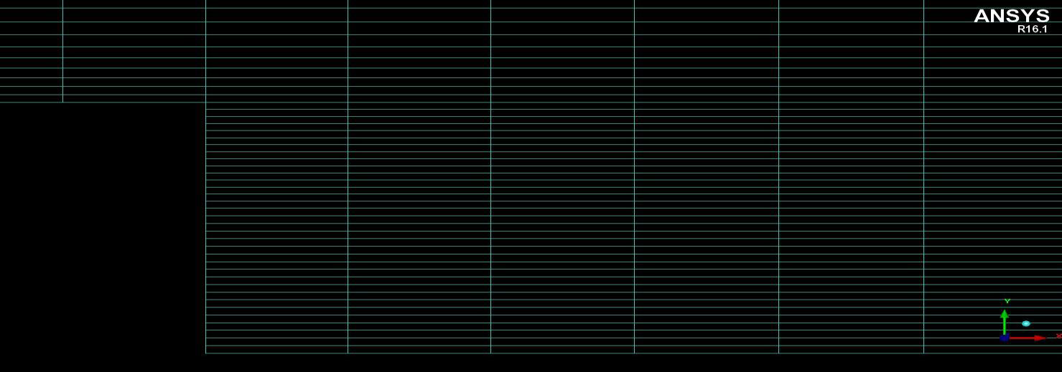
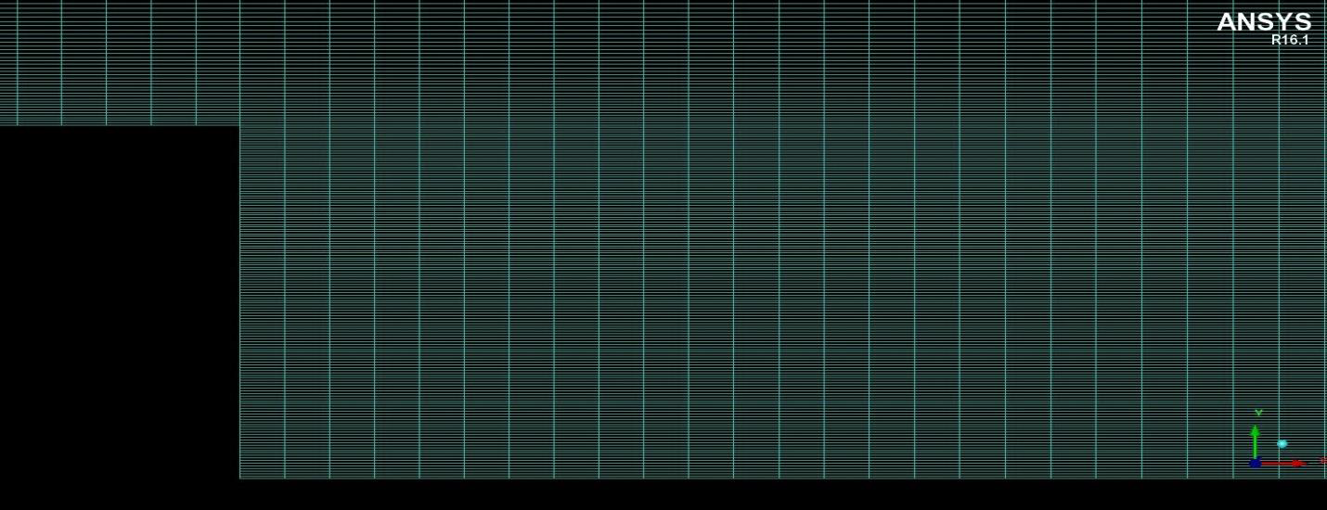
Computational Mesh
Parameter | Mesh 1 | Mesh 2 | Mesh 3 | Mesh 4
Type of Mesh | Hexahedral | Hexahedral | Hexahedral | Hexahedral
Number of Nodes | 3736 | 15568 | 63532 | 256660
Number of Elements | 7665 | 31530 | 127860 | 514920
Max Aspect Ratio | 22.57 | 24.54 | 25.59 | 26.52
Min Angle | 90° | 90° | 90° | 90°
Mesh 2
Mesh 4

Slide 41
Part I – Sandia National Laboratory Propane Jet
Experimental Reference
Robert W. Schefer “Data Base for a Turbulent, Non-premixed, Non-reacting Propane-Jet Flow “, Sandia National Laboratories Research Report, 1985, pp. 1-21.
R.W.Schefer and R.W.Dibble, ”Mixture Fraction Field in a Turbulent Non-reacting Propane Jet”, AIAA Journal, Vol.39, no.1, pp.64-72, 2001
Measuring Instrument | Quantities measured
Laser Doppler Anemometer (LDA) | Velocity
Rayleigh Scattering | Mixture fraction

Slide 42
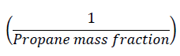
TIBC – Results comparison
For the purpose of comparison, two new non-dimensionalised quantities were introduced to compare the velocity and the mass fraction decay along the axial direction.
Velocity u invariant (U invar)
where, U_{cl} is the centerline velocity, U_{air} is the constant velocity of co-flow air 9.2 m/s,
Velocity u is the result obtained from the numerical calculation.
Propane mass fraction invariant (PMF invar)

Slide 43
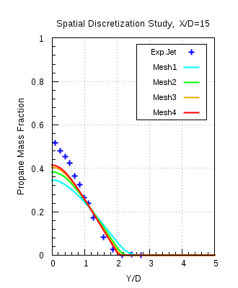
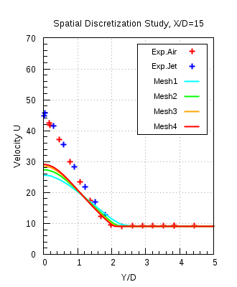
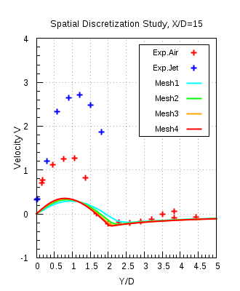
Spatial Discretisation Study (Mesh independency)
ANSYS CFX 16.1,
K-ω SST
Mesh 4 is chosen for further investigations

Slide 44
Boundary Conditions (Variable density)
Name | ANSYS CFX 16.1 | ANSYS Fluent 17.0
Co-flow inlet | Normal Velocity = 20 [m/s] Turbulent Intensity = 2 % Turbulent viscosity ratio = 10 | Normal velocity = 20 [m/s] Turbulent Intensity = 2 % Turbulent viscosity ratio = 10
Fuel Inlet | Normal Velocity = 50* [m/s] Turbulent Intensity = 5 % Turbulent viscosity ratio = 10 | Normal Velocity = 50* [m/s] Turbulent Intensity = 5 % Turbulent viscosity ratio = 10
Outlet | Average static pressure Relative pressure = 0 [Pa] Pressure profile blend = 0.05 | Average static pressure Gauge pressure = 0 [Pa] Pressure profile blend = 0.05
Bluff body | No Slip wall | No Slip wall
Wall 1 & 2 | No Slip wall | No Slip wall
Symmetry 1 & 2 | Symmetry | Symmetry
*Note: The velocities at jet inlet will depend on the experiments performed as mentioned in the literature

Slide 45
Experimental References
Sandia National Laboratory Propane Jet:
Robert W. Schefer “Data Base for a Turbulent, Non-premixed, Non-reacting Propane-Jet Flow “, Sandia National Laboratories Research Report, 1985, pp. 1-21.
R.W.Schefer and R.W.Dibble, ”Mixture Fraction Field in a Turbulent Non-reacting Propane Jet”, AIAA Journal, Vol.39, no.1, pp.64-72, 2001
2. Sydney Bluff Body Jet:
The University of Sydney, Department of Mechanical and Mechatronic Engineering and Sandia National Laboratories Combustion Research Facility, “Turbulent Non premixed Combustion Data for Piloted and Bluff-Body Stabilized Flows”
http://sydney.edu.au/engineering/aeromech/thermofluids/bluff.htm

Slide 46
Quality Assurance
The following investigations have been carried out in order to assure the quality of the CFD simulation:
Iteration error
dependence of CFD solution on the strength of the applied convergence criterion
Spatial Discretization error
grid independence of the CFD solution
Turbulent inlet boundary condition study
Turbulent Schmidt number (Sc_{t}) study
different Sc_{t} ranging from 0.6 – 0.9 are used to study with which Sc_{t} the result with best accuracy is delivered
Model error
comparison of SST, k-ω, k-ԑ, BSL RSM and EARSM turbulence models

Slide 47
ANSYS CFX 16.1 Model Error, Mesh 2
Comparison of the mixture fraction profiles with the experimental data.
The following turbulence models:
K-ω SST
k-ε
The results showed are computed with fuel CNG

Slide 48
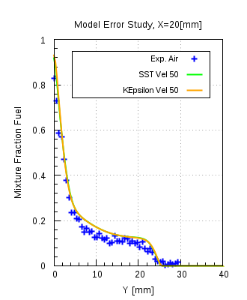
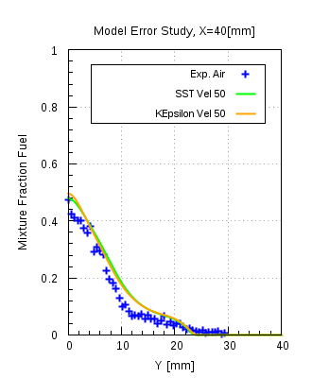

Model Error
CNG, Jet velocity = 50 m/s

Slide 49
ANSYS Fluent 17.0 Model Error, Mesh 2
Comparison of the mixture fraction profiles with the experimental data.
The following turbulence models:
k-ω SST
standard k-ε
realizable k-ε
The results showed are computed with fuel CNG

Slide 50



Model Error
CNG, Jet velocity = 50 m/s

Slide 51


Mass and Mixture fraction
Mass Fraction:
Mass fraction indicates the mass of a species (m_{i}) to the total mass (m)of all the species in a mixture
2. Mixture Fraction:
In a two-feed system a fuel stream (subscript 1) with mass flux m1 is mixed with an oxidizer stream (subscript 2) with mass flux m2.
The mixture fraction represents the mass fraction of the fuel stream in the mixture:
Both fuel and oxidizer streams may contain inerts such as nitrogen.

Slide 52

Positions (X) at which mixture fraction profiles have been extracted
X [mm] =
20
60.3
40

